Slide 1
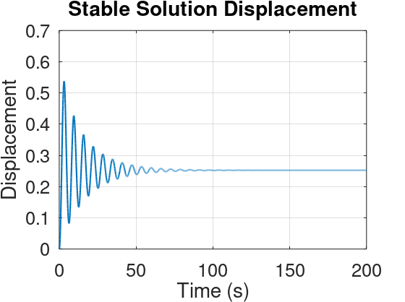
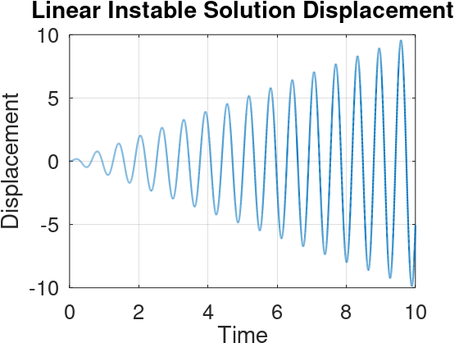
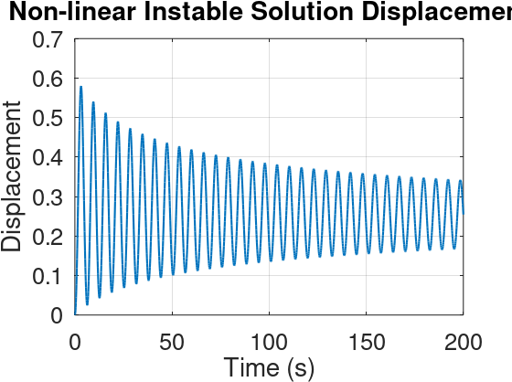
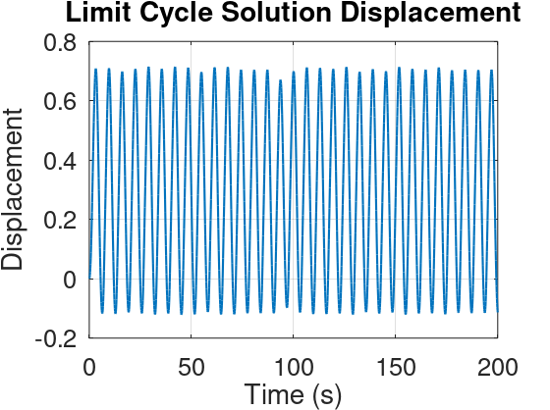
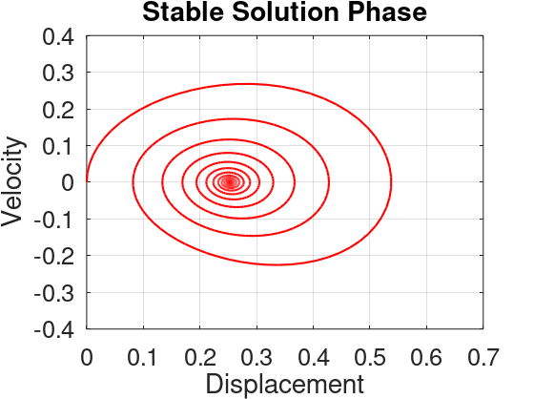
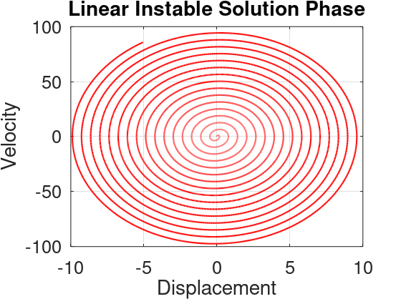
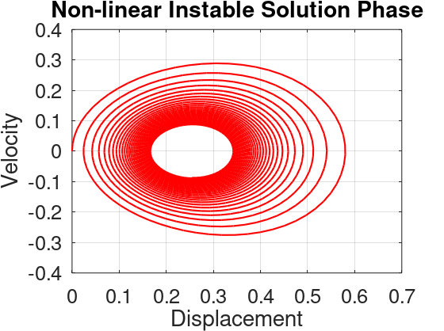
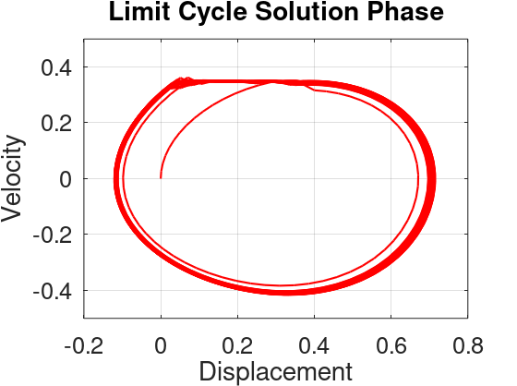
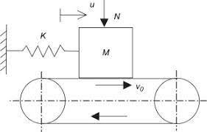
Summary of different solutions with the Basic Stick-Slip model in the Literature Survey
Stable Solution
Limit Cycle
Basic Stick Slip Model
V

Slide 2
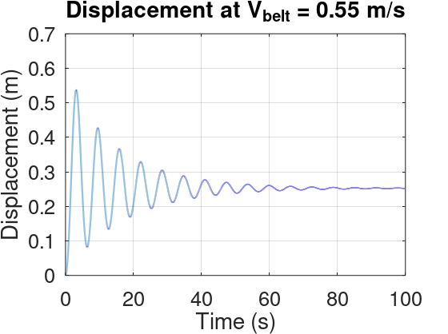
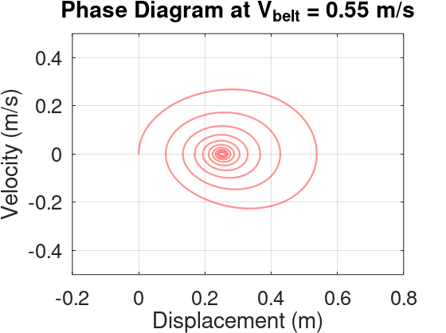
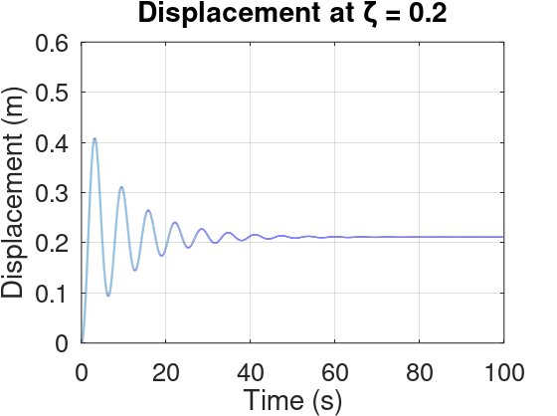
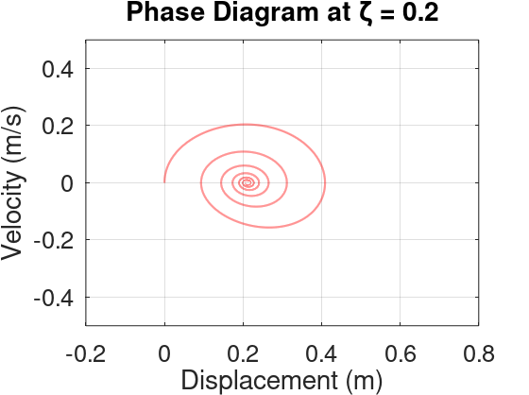
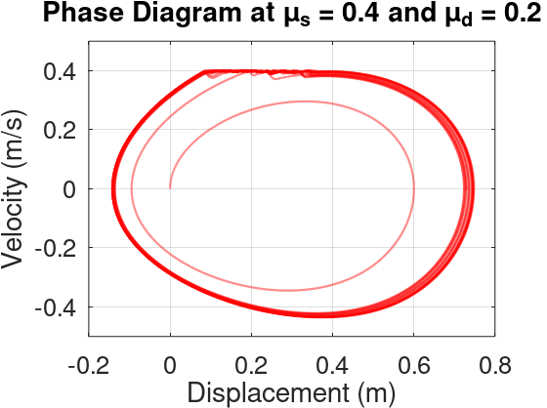
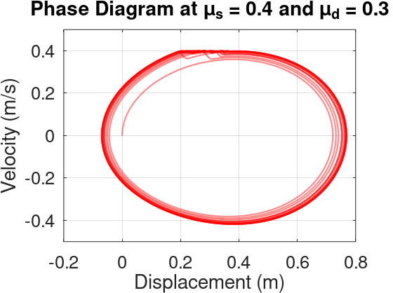
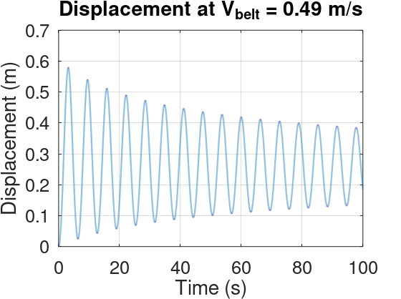
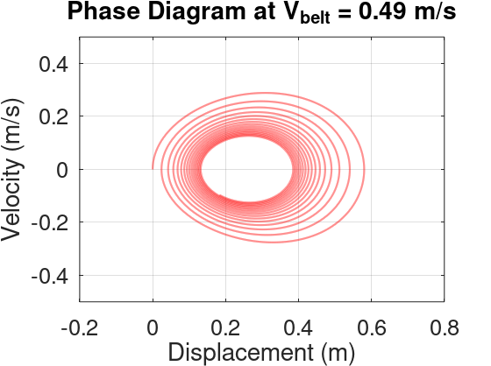
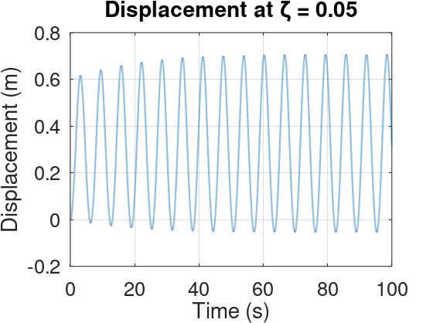
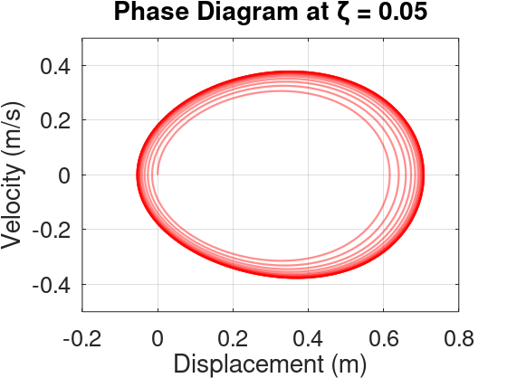
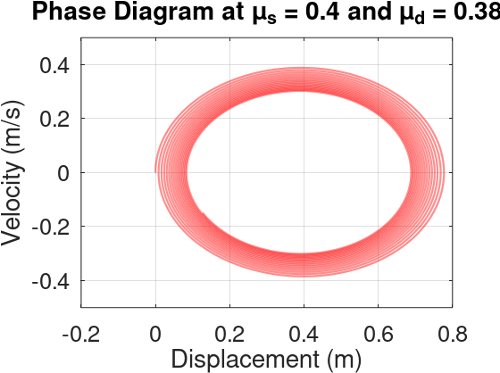
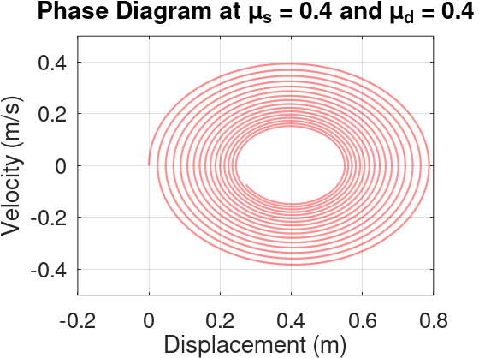
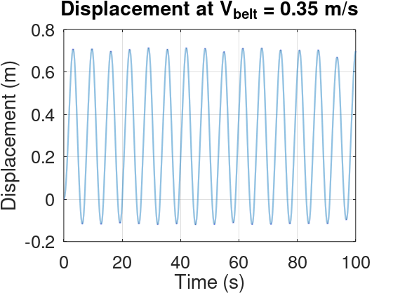
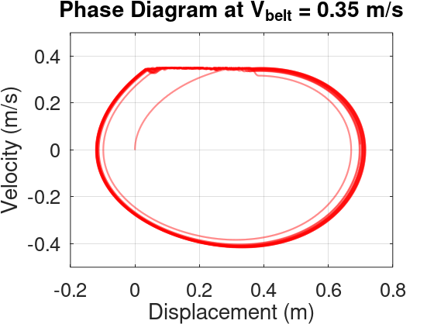
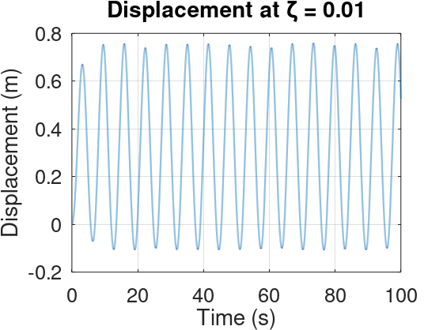
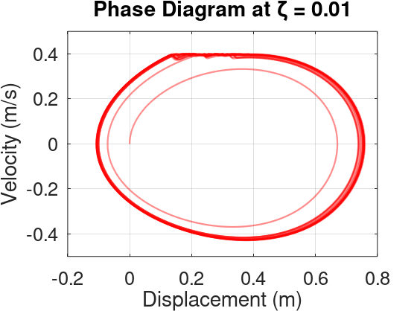
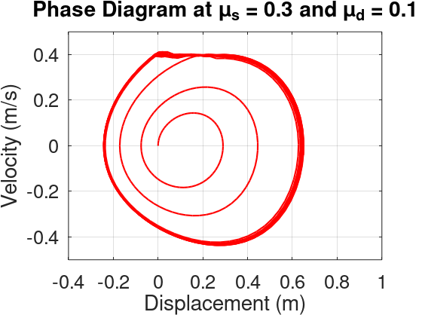
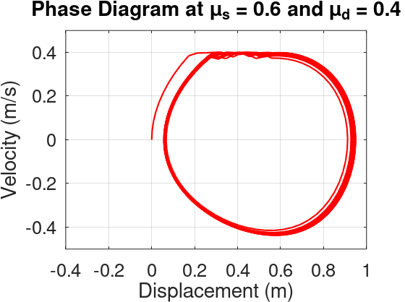

Slide 3
Disc Velocity
Brake Pad Damping
Friction Stability
Static to Dynamic friction difference
Axle Shaft Torsional Damping
Transverse damping of Shims

Slide 4
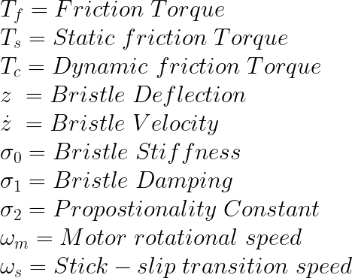
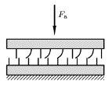


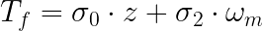
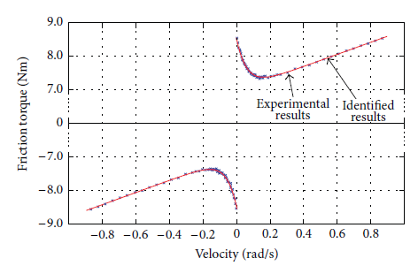
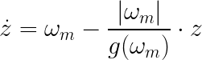
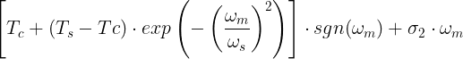
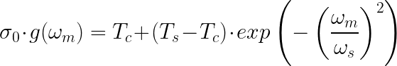
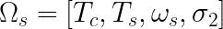
LuGre Friction model
Relative speed between the two surfaces is zero at steady rotor speed
Angular acceleration is zero
Relative bristle deflection zero
Bristle Velocity is zero
Experimental Setup [8]
Friction Torque Formulation
Friction Torque Estimation
Steady State Parameters

Slide 5
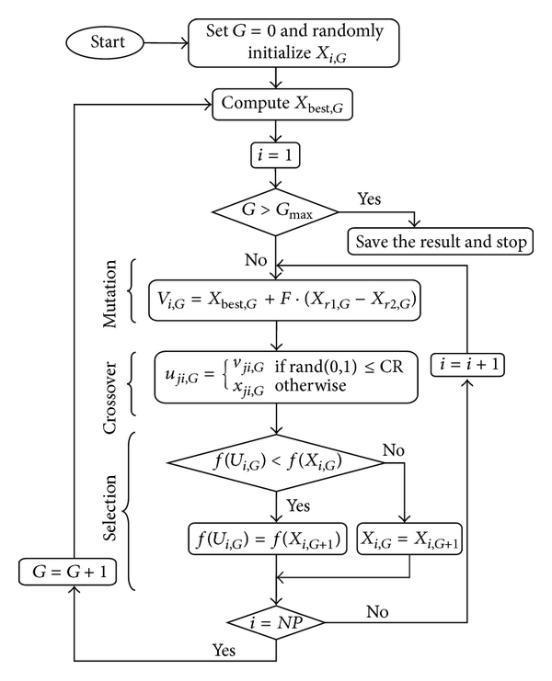
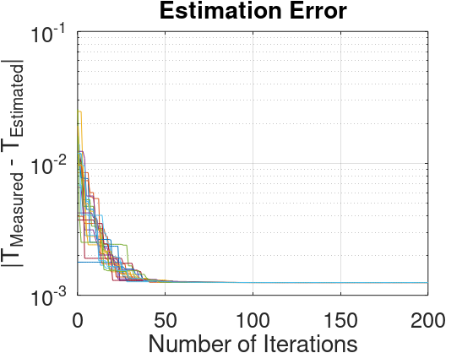

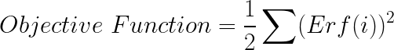
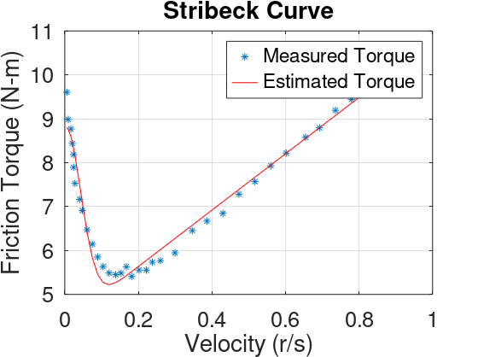
Steady State Parameters
Differential Evolution Algorithm
Repeatability
Computer
Specification
G = 200
Serial Computing
Ram = 128 GB
CPU = 2.4 GHz
Time ~ 12.5 s
Error Formulation
Objective Function
Parameter | Paper (TVM) | OCTAVE code (DE)
Dynamic Torque (N-m) | 6.975 | 4.352
Static Torque (N-m) | 8.558 | 8.802
Sigma_2 | 1.819 | 6.416
Sliding Speed (r/s) | 0.06109 | 0.0613
Population | - | 50
Cross Over Probability | - | 0.8
Selection Probability | - | 0.85
Mutation Probability | - | -

Slide 6
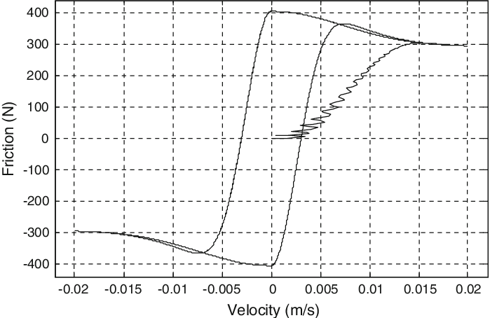
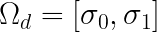
Friction Torque Formulation
Z(0) = 0
Z(T)
Dynamic Parameters
In the literature, torque is given as input and velocity is measured
We are measuring friction hysteresis by velocity cycle input
Measurement to be taken in pre-sliding region
Error Formulation
Objective Function

Slide 7
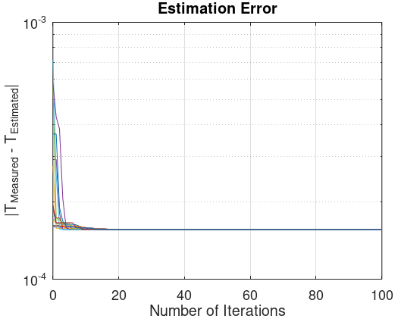

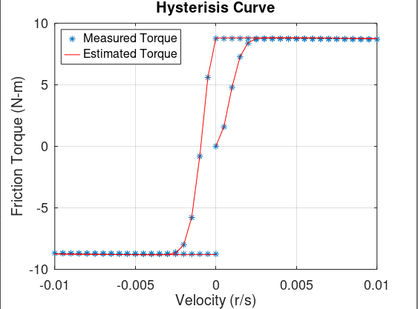
Dynamic Parameters
Repeatability
Computer
Specification
Error Formulation
G = 100
Time steps : 83
Serial Computing
Ram = 128 GB
CPU = 2.4 GHz
Time ~ 30 mins
Objective Function
Parameter | Paper (TVM) | OCTAVE code (DE)
Sigma_0 | 2750 | 2695.83
Sigma_1 | 45.2 | 174.04
Population | - | 50
Cross Over Probability | - | 0.8
Selection Probability | - | 0.85
Mutation Probability | - | -

